Slide 1
Microsoft Azure Application Insights
Shimail Gillani
Cloud Solution Architect
Microsoft Education
Notes:
(Introductions and set expectations that this presentation is designed to discuss the role of Azure as the cloud computing platform for a business’s digital transformation.)

Slide 2




Shimail Gillani – Cloud Solution Architect ( aka @ChefGillani )
Recently Moved to Dallas, from New Jersey
Hybrid DevOps – 20+ Years (3 at Microsoft and Previously Ernst & Young)
MS Customer Success Unit - Solutions Architects team
Currently Helping:
Duke, U-Miami, U-South Florida, U-Texas,
Dallas and Minnesota – Colleges and University System
Previously Helped: Yale, Princeton, Johns Hopkins and U-North Carolina
Shimail.Gillani@Microsoft.Com Twitter: @ChefGillani GitHub: ChefGillani
Team Blog: https://blogs.msdn.microsoft.com/AzureEdu
Notes:
Technology is omnipresent. It’s shaping how businesses plan for innovation and growth within their markets. The importance of digital transformation is urgent; Since 2000, 52% of Fortune 500 companies are gone due to digital disruption.
We see companies responding by creating digital strategies across four core areas: engaging their customers, empowering their employees, optimizing their operations, and transforming their products.
Everyone is aware of how important this is. Look at a company like Uber for example. They’ve created a digital model for the taxi industry that has allowed them to surpass every other taxi company by double or more, recently valued at $62.5 Billion. They’ve created a significant shift in an industry that has been largely untouched for decades.

Slide 3

What does Application visibility mean to you?
Diagnose problems across my app, VMs, networks, and PaaS services
Show exec dashboards of application SLAs & KPIs
Understand & optimize performance of my app
Track usage, engagement & retention of my app
Detect & debug the errors in my apps
Is there is a security threat!!!!!
Notes:
Monitoring means different things to different people. While you might be focused just on application monitoring, there are cases where you might want to also look at infrastructure & platform for correlations, and that is where “Azure Monitoring & Analytics” provides an integrated consolidated solution.

Slide 4



Develop + Build
Test + Stabilize
Deploy + Maintain
Traditional Monitoring

Slide 5
Develop + Build
Test + Stabilize
Deploy + Maintain
Continuous Monitoring

Slide 6


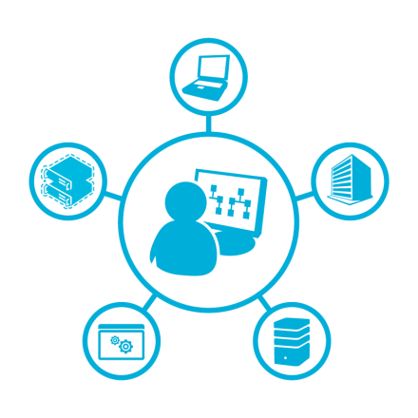
Holistic Azure Monitoring
Azure Monitoring Strategy & Vision
Advanced Analytics Platform
Scale & Complexity
Value to Business
Notes:
Our Mission: Empower developers to create better apps: reliable, performant, trustworthy.
Our Vision: Application Insights will make the overall Azure offering better for developers by providing the best solution for monitoring, diagnosing and analyzing apps.
Provide mature, scalable, holistic APM capabilities intrinsic to Azure that help customers detect, diagnose, and analyze common issues leveraging pre-built views
Provide advanced analytics capability that will enable them to go in-depth, get answers to probing questions unique to their application and business needs with the ability to share the knowledge gained in the process with the rest of the team
Continually improve our product to support scale & complexity in enterprise scenarios including composite app topology views, cross component queries, smart adaptive scaling & a unified view for management
Expand to enable development teams to succeed with their app by providing intelligence on customer adoption and engagement.
Value to Business: SLA + KPI + Customers

Slide 7
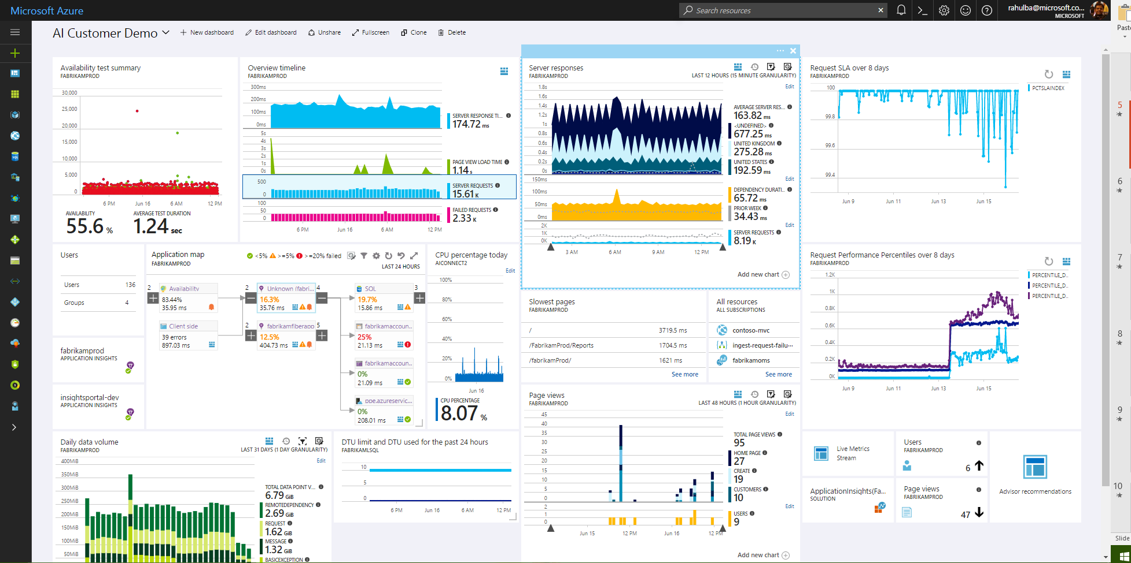
Azure Application Insights
Health Check
Monitor & Optimize
Detect & Debug
Data Analytics
Take Actions
Export & Correlate
DevOps Workflows
Customer Insights

Slide 8






Application Insights Ecosystem
Ingestion
Exploration
Export & Correlation
Application Insights
Microsoft Azure Portal
OMS Connector
Power BI
Open Source SDKs
Status Monitor
Azure Extensions
Azure Monitor
Application Map
Live Metrics Stream
Profiler & Debugger
Microsoft Azure dashboards
Blob storage
Visual Studio Team Services
SCOM MP Open Schema
Visual Studio IDE
Analytics Portal
Data Access APIs
Support
ASP.NET
ASP.NET Core
Java - J2EE
Windows Desktop
WCF
JavaScript
Node.JS
PHP
Python
Ruby
Angular
Docker
Kubernetes
Dynamics CRM
Azure Web Apps
Azure Cloud Services
Azure VMs
Azure Functions
Azure Service Fabric
Glimpse
Spring
Log4Net/NLog
Log4J/Logback
System.Diagnostics
Semantic Logging (SLAB)
ETW/EventSource
LogStash
Collectd
Concrete
Drupal
Joomla
SharePoint
WordPress
Orchard
OSS/Public Endpoints
…

Slide 9
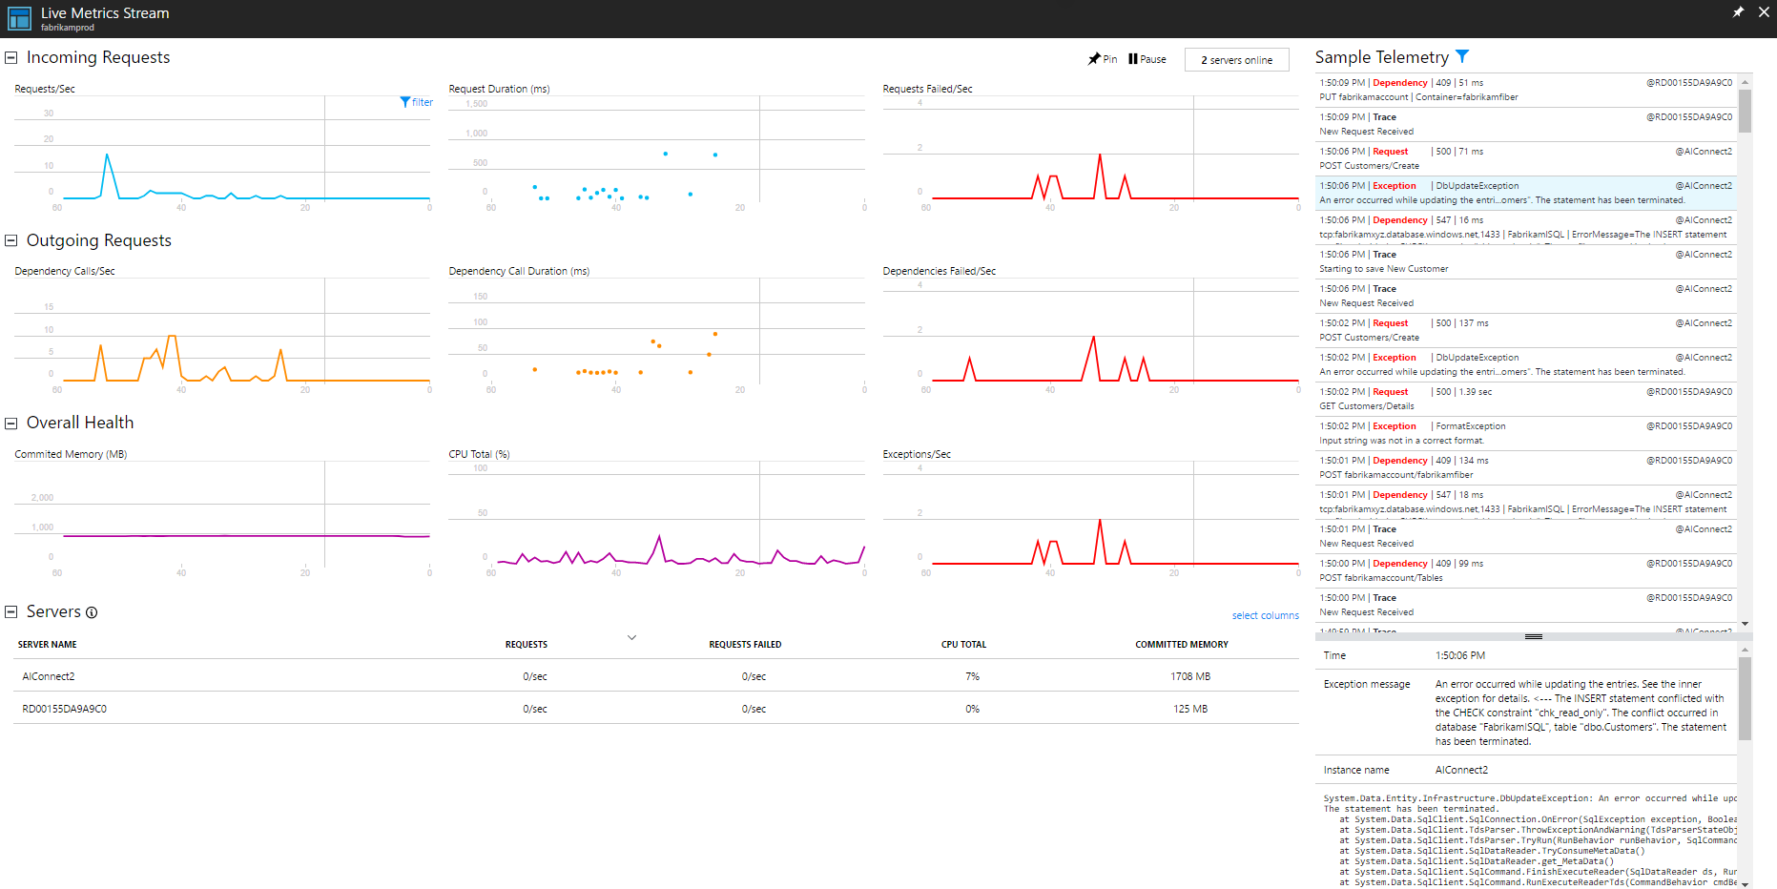
Real Time Health Check
Notes:
Automatically detect performance degradations in dependent services or infrastructure and correlate with app performance. Drill down to profiler examples and view code level breakdown of time spent executing the request.

Slide 10
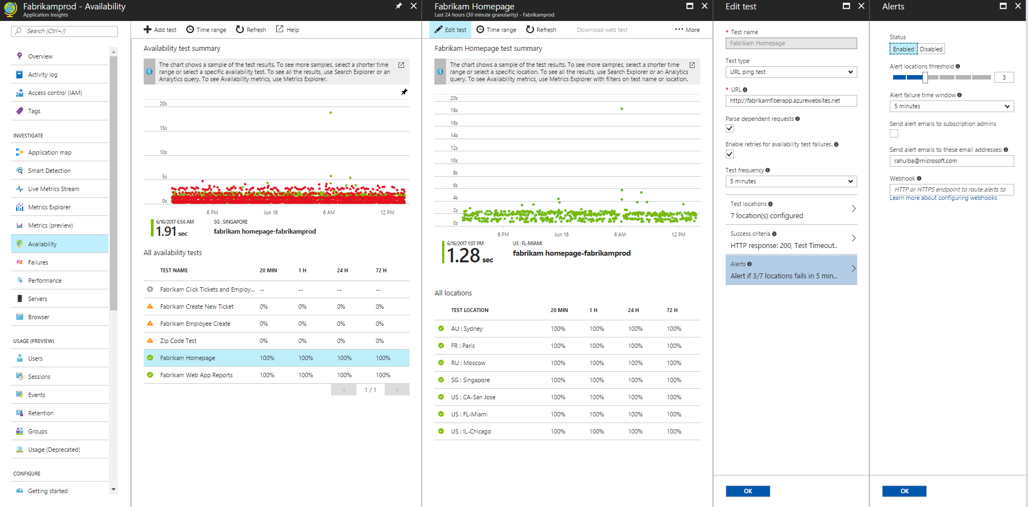
Synthetic Availability Monitoring

Slide 11
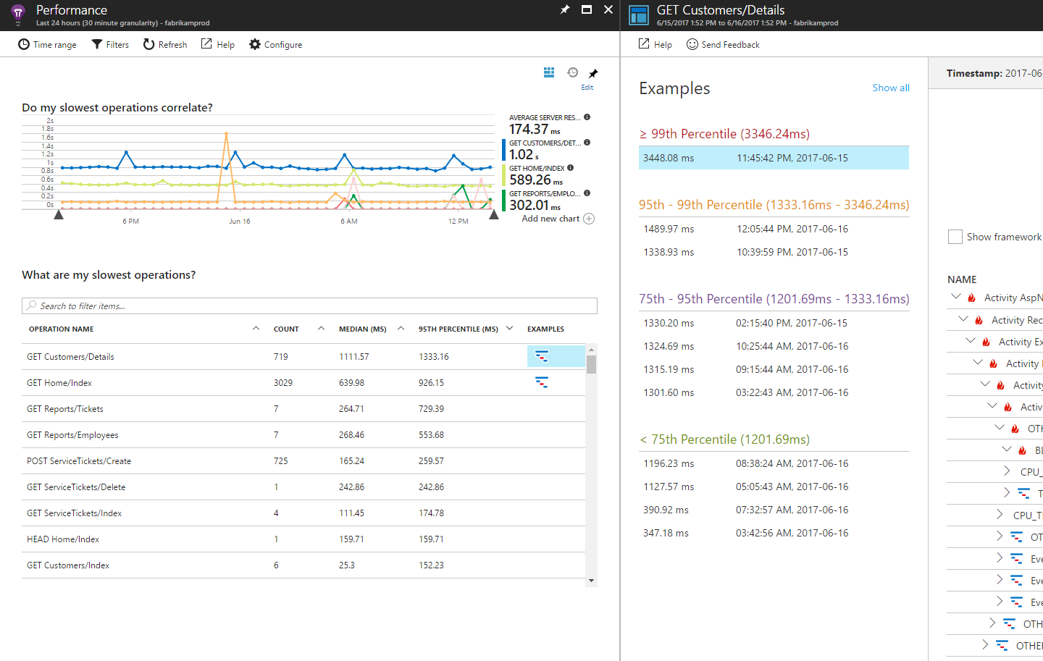
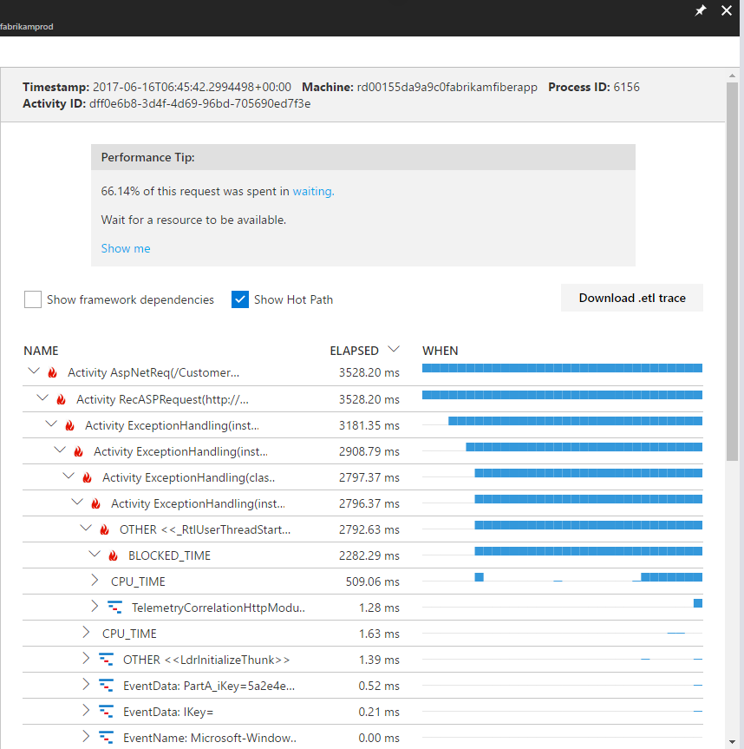
Performance Monitoring & Profiling

Slide 12
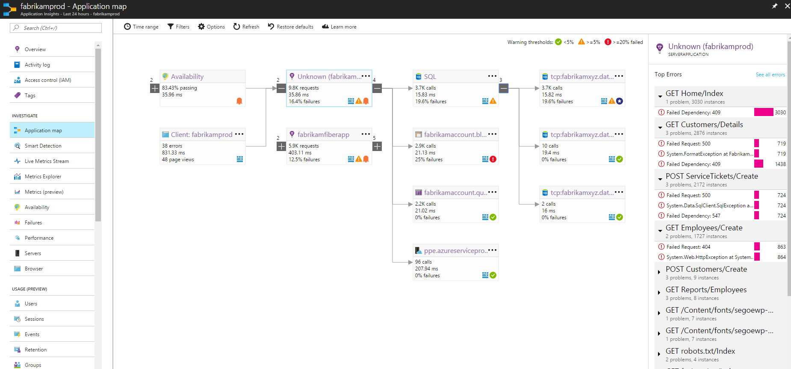
Application Topology

Slide 13
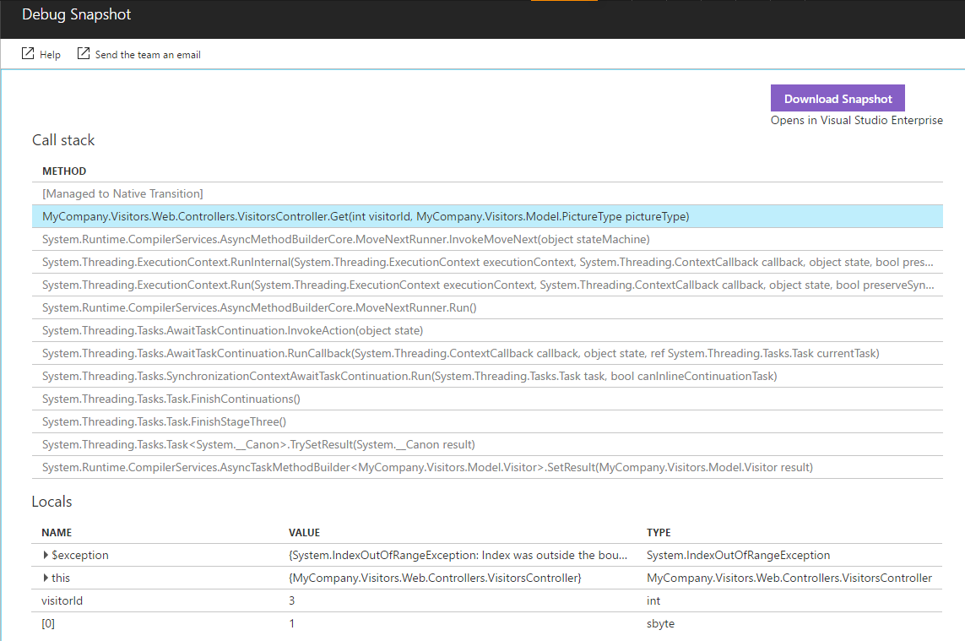
Snapshot Debugging in Production
Notes:
Capture debug snapshots at the point when exceptions are thrown in your application. View snapshots in the portal to see variables and parameters in code and open them with Visual Studio Enterprise for a full snapshot debugging experience.

Slide 14
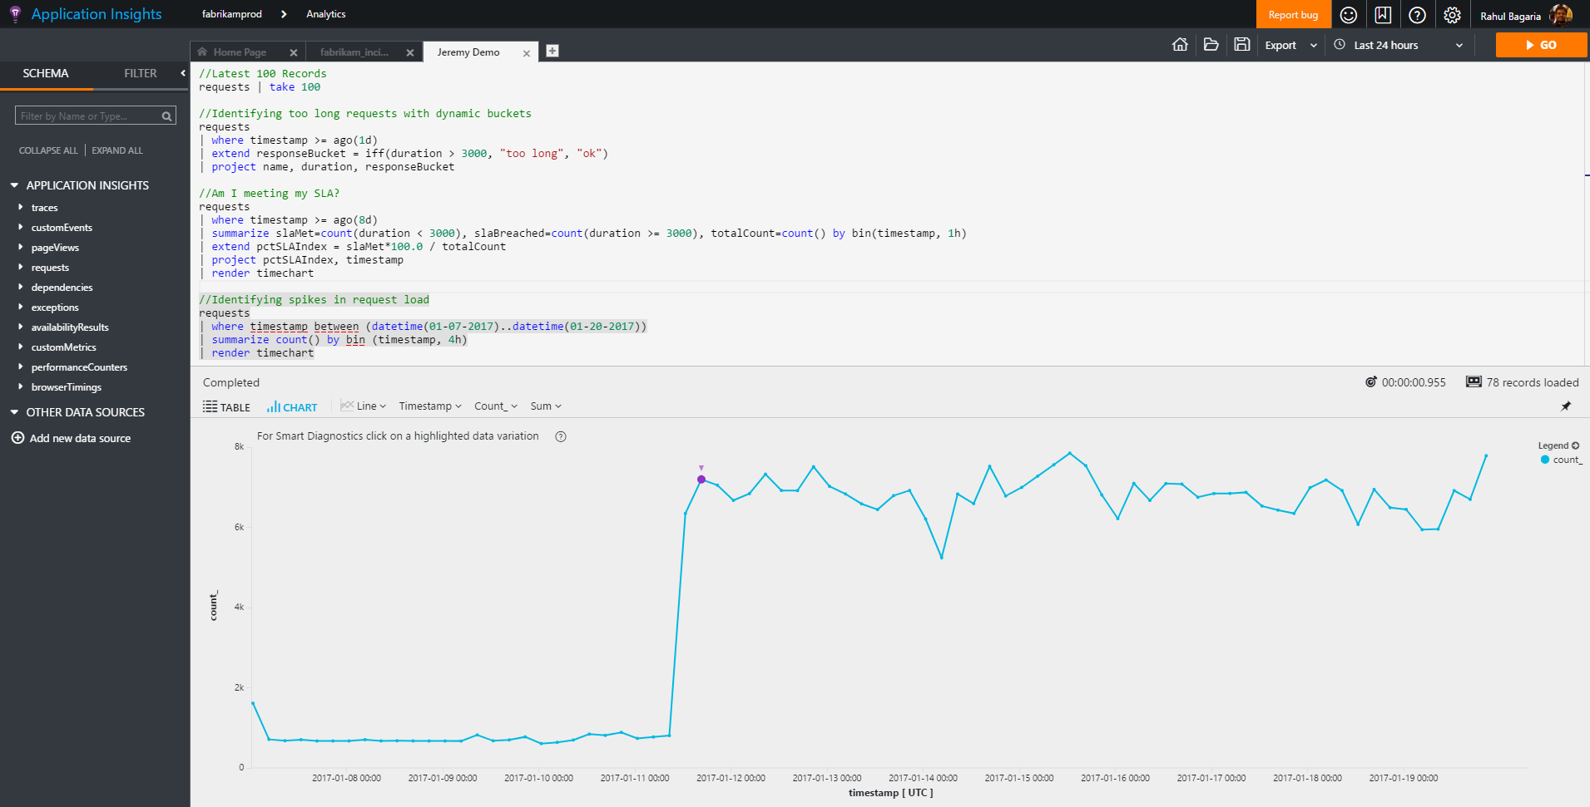
Ad-Hoc Data Analytics

Slide 15
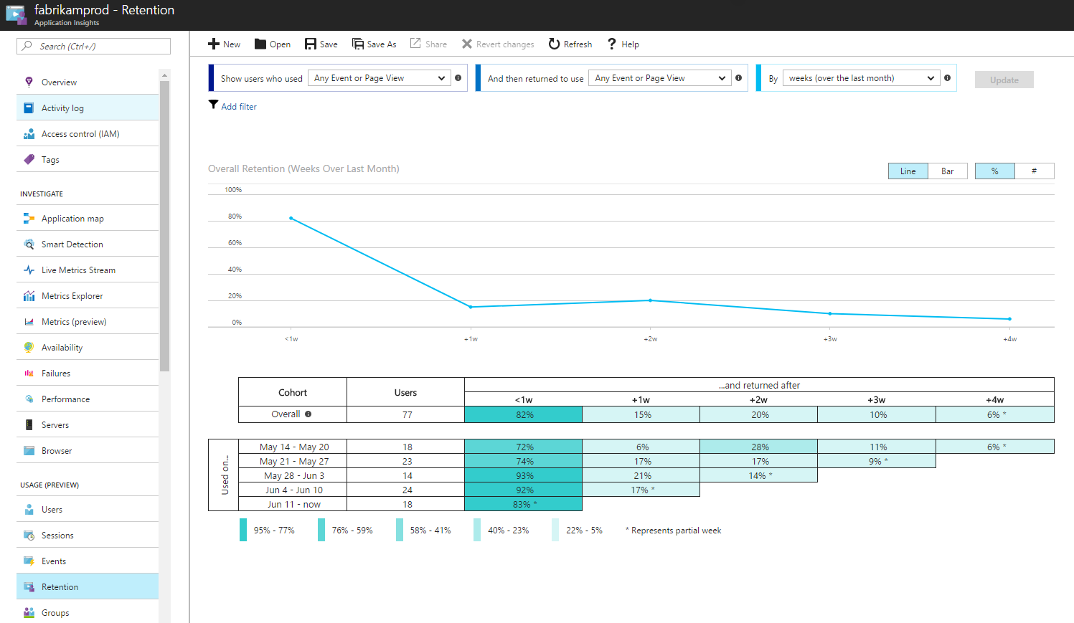
Customer Insights

Slide 16
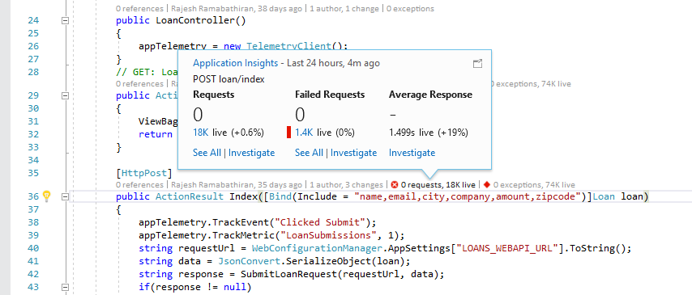
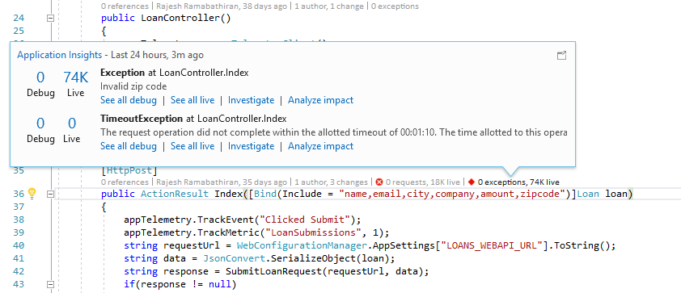
CodeLens Integration in Visual Studio

Slide 17
Summary
Tweet @Azure
Continuous Monitoring through the DevOps Lifecycle
Powerful Monitoring, Debugging & Profiling
Deeper Insights with Machine Learning & Ad-Hoc Analytics
Get started for free!
http://aka.ms/AIGetStarted
Read about our announcements on Azure Blogs
Follow our investments on Azure Roadmap
Check out our \\Build recordings on Channel 9

Slide 18
Thanks for Joining
Shimail Gillani
Cloud Solution Architect
Microsoft Education
Notes:
(Introductions and set expectations that this presentation is designed to discuss the role of Azure as the cloud computing platform for a business’s digital transformation.)

